Slide 1
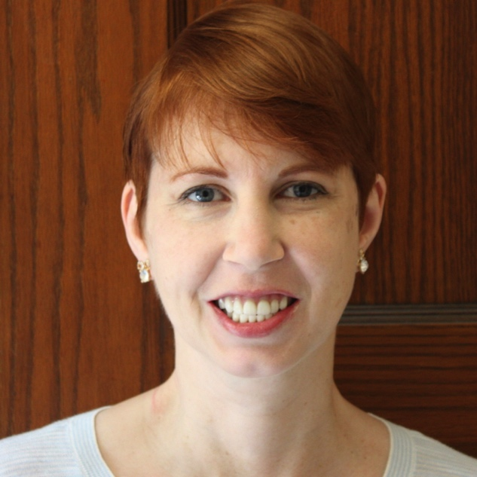
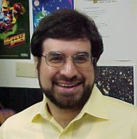

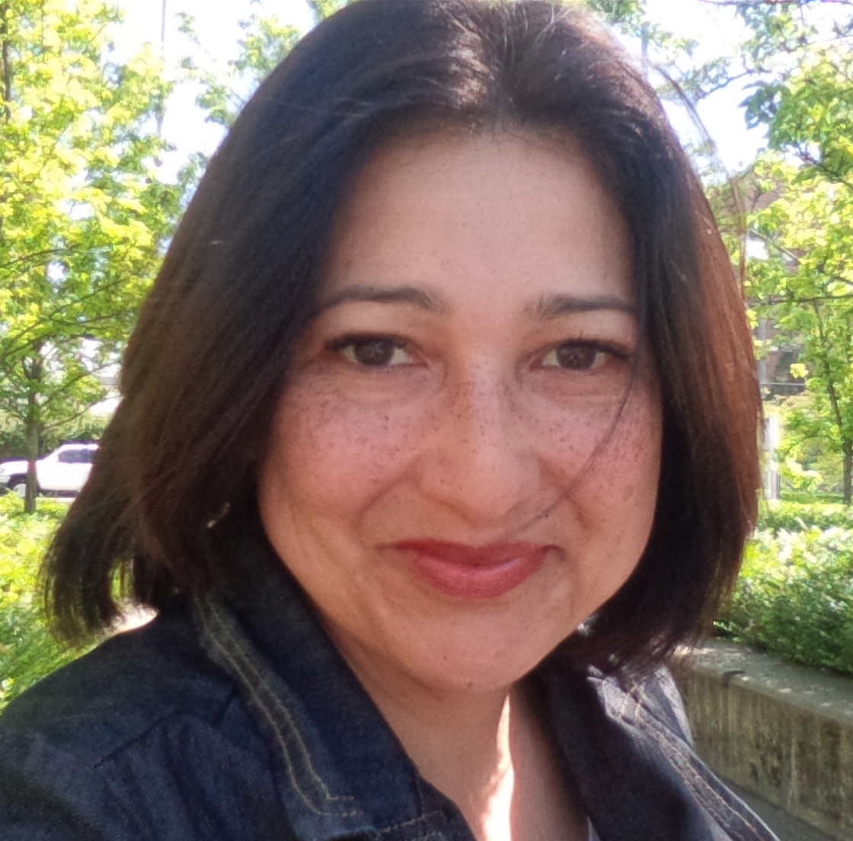



Professional Development workshops in Colombia: Preparing faculty across the academy to teach in PER-inspired active learning classrooms
Rebecca Lindell, Luanna Gomez & Jeff Saul
Tiliadal STEM Education Solutions
Tiliadal STEM Education Solutions
Abstract
Much of physics education research since the 1990’s has focused on identifying methods by which large-enrollment introductory physics courses may be taught more effectively than the traditional lecture. The research has provided insights about what student-centered active learning looks like in a variety of teaching settings and its implementation. As institutes of higher education chose to incorporate active engagement classes for the first time, the PER community has increasingly been sought to conduct professional development in subject areas other than physics. In this poster we describe our professional development workshops for two Colombian universities. The workshops are meant to facilitate effective ways that their faulty may incorporate active learning techniques in non-traditional learning spaces, including SCALE-UP classrooms, for a wide range of subjects.
EAFIT University
Medellín, Colombia
Located in urban Medellín, Colombia, Universidad EAFIT offers undergraduate and graduate studies in science, humanities, management, engineering, law, and economics & finance. The student population consists of approximately 80% undergraduate (10,000) and 20% graduate (2,500) students. Considered among the top 10 most prestigious universities in the country, EAFIT annual tuition for local undergraduates ranges between $2,500 and $5,000 USD. Students are admitted on the basis of their entrance examination performance. (The average admission rate is about 65%.)
Overview
Earlier this year we were contacted by Natalia Ronderos Barreto, Director of Educational Support, of Tadeo University, Bogota, Colombia and Maria Zuluaga Lopez, Educational Advisor for Project 50, of EAFIT University, Medellin, Colombia to discuss the possibility of us giving a series of workshops. They desired workshops to introduce their faculty to teaching in their new innovative learning spaces, including several SCALE-UP classrooms. After several months of discussions with Natalia and Monica we agreed to lead multi-day workshop at each school focusing on active learning within the specific learning spaces, SCALE-UP rooms, and lecture halls. The EAFIT workshops is scheduled July 31 through Aug 2, 2017.
TADEO University
Bogotá, Colombia
UTADEO is a private university located in Colombia’s capital city, Bogotá. Annual enrollment ranges from 9,000 to 10,000 students. More selective than EAFIT, the university’s admission rate is 30%– 40%. In addition to baccalaureate and graduate degrees, UTADEO offers pre-bachelor degrees such as certificate and associate degrees. There are schools of art & design, social sciences, natural sciences & engineering, and economic & administrative science. The yearly tuition range is $1,000 - $2,500 USD.

Slide 2
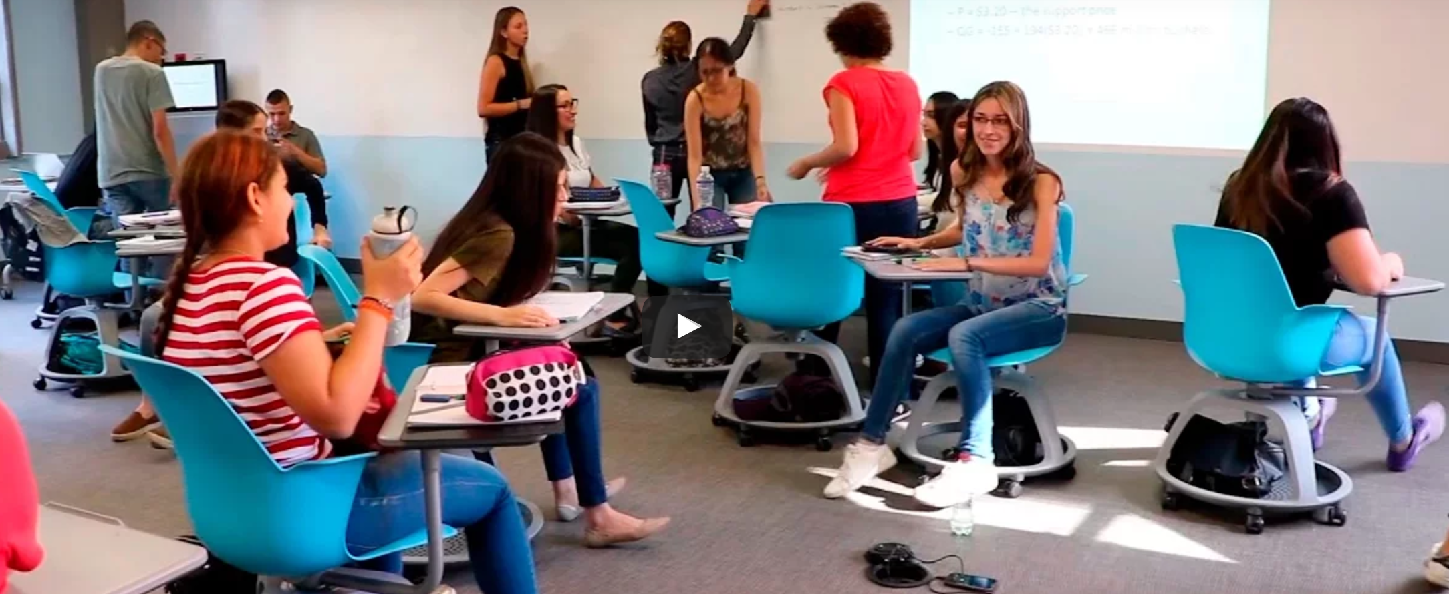
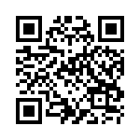
EAFIT Workshop Overview
Monday July 31st
Description: Multiple studies on how students learn have found the most effective innovation is switching from thinking about the best way to present course material as an instructor to how best to help students develop the skills and knowledge needed to master the course material. The most effective reforms are those that have students working in teams on activities that help them work on the course material themselves with coaching from the instructor. This session will discuss the process of how instructors can make this transition. Open to everyone.
Session B: Assessing Student Learning and Learning Outcomes
Description: Switching to a student-centered approach requires thinking about what you want students to learn from your course, how you measure their success, and how you teach them to achieve that success. In this session, we will discuss constructing learning objectives for your students, using these to develop measurable outcomes, and developing assessments to measure student success based on outcomes. Lastly, we will discuss how to use the feedback from your assessments to improve your course outcomes in the future. Open to Everyone.
Session C: Evaluating your instruction and what to do if they don’t like it?
Description: Evaluating instruction often relies on a combination of students’ performance, expectations, and attitudes. In this session, we will discuss different methods for each type of evaluation. We will also discuss how instructors may improve their results. Open to Everyone.
Tuesday August 1st
Session D: Incorporating Active-Learning in your Teaching
Description: There are many different ways to successfully incorporate and manage active learning in your classroom. This session will discuss and demonstrate multiple active learning options including the instructors’ shifting roles. Open to Everyone.
Session E: Breakout Sessions -- Creating Student Centered Activities in Different Learning Environments
Description: The specific instructional setting presents unique opportunities as well as different constraints for implementing active learning in classroom instruction. The breakout sessions will discuss and demonstrate activities appropriate to each of the three classroom environments. Open to Everyone.
Wednesday August 2nd
Session F: Facilitating and Sustaining Curriculum Innovations
Description: Change is hard and sustaining change is even harder. This session will discuss ways to support and reward faculty who want to include more activity-based learning in their classes. We will also discuss strategies to help departments and institutions sustain curriculum reforms. For Project 50 team only.
Session G: Consultations with Course Development Teams
Description: During this session, each active-learning course transformation team will meet with one of the consultants for 45 minutes to discuss their plans for implementing their proposal. For member of Active Learning Teams only.
Sponsorship
This workshop is sponsored by EAFIT University Pronject 50, Tadeo University office of education support as well as Colombia’s Ministry of Education.

